Slide 1

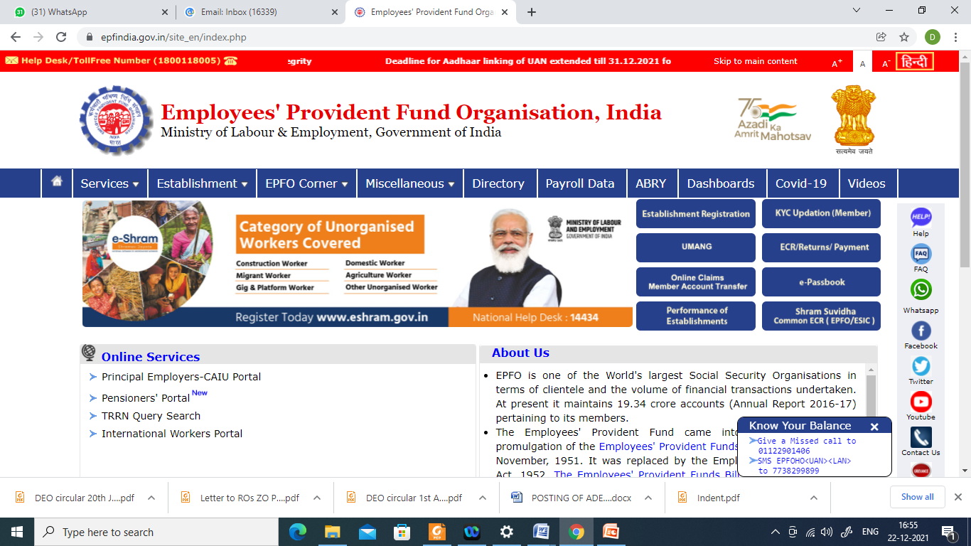
EPFO WEBSITE - www.epfindia.gov.in

Slide 2
QUICK E NOMINATION AND ZERO ERROR
Take one page and write down the following details :_
1. Name, present address, permanent address, bank details (available now), photo from camera having ear should be seen.(Size from Galary should be minimise less than 100 kb in jepg or jpg format of all nominees.(Size 3.5 cm x 4.5 cm)
2. If Aadhar and bank details of nominee in category of son and daughter or case may be not available then DO QUICK NOMINATION of HUSBAND, WIFE, FATHER, MOTHER as per classification immediately giving percentage of share accordingly. After receipt of details of Nominees {son or daughter or other nominee as per classification) please update nominee again as per your time. Firstly QUICK NOMINATION should be done then time is their to update nominee in few days of son or daughter or other nominees as per classification. This will curtail your time and Quick E-nomination can be done immediately.
3. To avoid Error :- Having family choose correct details, for bachelor having father and mother – choose {having family – YES} if spinster category – Having family choose –{ NO }then proceed for E-Nomination having all above details.

Slide 3
QUICK E NOMINATION – RESOLUTION OF ERROR
4.. PASSPORT SIZE PHOTO 3.5 cm x 4.5 cm or less than 100 kb appearing both ear and face of all nominee and kept it ready in Galary section of Mobile/or in laptop or PC. Please use your adriod mobile or take the assistance of CSC Centre. You can update good quality of passport size photo later on anytime. You can update your nomination anytime.
5. Please ensure Aadhar of Nominees are updated with mobile with the help of Aadhar Centres. There are 3 lacks CSC Centres in India. Visit once and secure your family by doing E NOMINATION.
6. LINK AADHAR WITH UAN, KYC SHOULD BE COMPLETED
7. ALL BANK ACCOUNT IN ONE BANK FOR EPS NOMINATION. If it is not available, please open accounts in 7 banks for EPS Nomination updation as per Geographic Jurisdiction of Mumbai Pune etc. For EPF/EDLI Nomination bank account of any bank required. If you have no bank details of particulars banks for EPS, then Atleast first update bank details available and then after opening of bank account update again. (FOR EPS – BANK ACCOUNTS SHOULD BE OPENED IN Bank of India, State Bank of India, Bank of Maharashtra, Punjab National Bank, HDFC BANK, ICICI BANK, AXIS BANK. Please ensure that all banks account
8. FOR DIVORSE CASE. You have to select unmarried. Then update your nomination. Having family “ Yes” and update other details as per classifications.
12. For Spinster – Select unmarried and having no family. Then proceed to your nomination.

Slide 4
E- NOMINATION (INTRODUCTION)
  The ultimate objective of maintaining a nomination (Form-2) is to ensure that funds are made available in a timely manner to the nominee in the unfortunate event of the death of the member. Hence it is important to ensure that every EPF / EPS member has provided information of his/her nominee’s details to enable settlement of funds.
  Employees' Provident Fund Organisation (EPFO) allows subscribers to submit their Provident Fund (PF) account's nomination details online via its official portal- unifiedportal-mem.epfindia.gov.in.
  Only the nominated members can withdraw the EPF savings in the event of subscribers' sudden demise.
  Subscribers can nominate more than one nominee and also fix the percentage of sharing among all such nominees.

Slide 5
E- nomination (RULES)
  If member has a family at the time of making nomination, then it shall be in favour of one or more persons belonging to his family for EPF/EDLI Schemes and any nomination which is already made by such member in favour of any person not belonging to his family shall be invalid.
  A fresh nomination shall be made by the member on his marriage and any nomination made before such marriage shall be deemed to be invalid.
  At the time of making nomination, if the member has no family, the nomination may be in favour of any person or persons but if the member subsequently acquires a family, such nomination shall be deemed to be INVALID and the member shall make a fresh nomination.

Slide 6
E- nomination (CLASSIFICATION)
  There are two type of Nominations for EPF/EDLI and EPS schemes depending upon members marital status.
    a) If the member is Bachelor
    b) If the member is Batchelor or Spinster and NO Family
    a) If the member is Spinster having & does NOT Family
GENDER | EPF/EDLI SCHEME | EPS SCHEME
Male OR Female | Dependent Parents Or Any one of the family members | Dependent Parents OR Any one of the family members
 | (Nomination can be made for one or more persons belonging to his family duly mentioning the % of share)
GENDER | EPF/EDLI SCHEME | EPS SCHEME
Male OR Female | Any person OR persons | Any person
 | (Nomination can be made for one or more persons duly mentioning the % of share

Slide 7
E- nomination (CLASSIFICATION)
If the member is a Married Person :-
GENDER | EPF/EDLI SCHEME | EPS SCHEME
Male | Wife Children Dependent parents Deceased Son’s widow & Children | Spouse & Children including legally adopted children
Female | Husband Children Dependent parents Deceased Son’s widow & Children | Spouse & Children including legally adopted children
 | Note- Nomination can be made for one or more persons belonging to his/her family duly mentioning % of share

Slide 8
E- nomination (pre-requisites)
UAN should be activated.
Verified Aadhar should be linked with UAN.
Mobile number should be linked with Aadhar.
Member UAN profile should be updated with all details including address and passport size photograph.
Passport size photos of all nominees (size 3.5 cm x 4.5 cm).
Aadhar, Address & bank account details of all nominees.

Slide 9
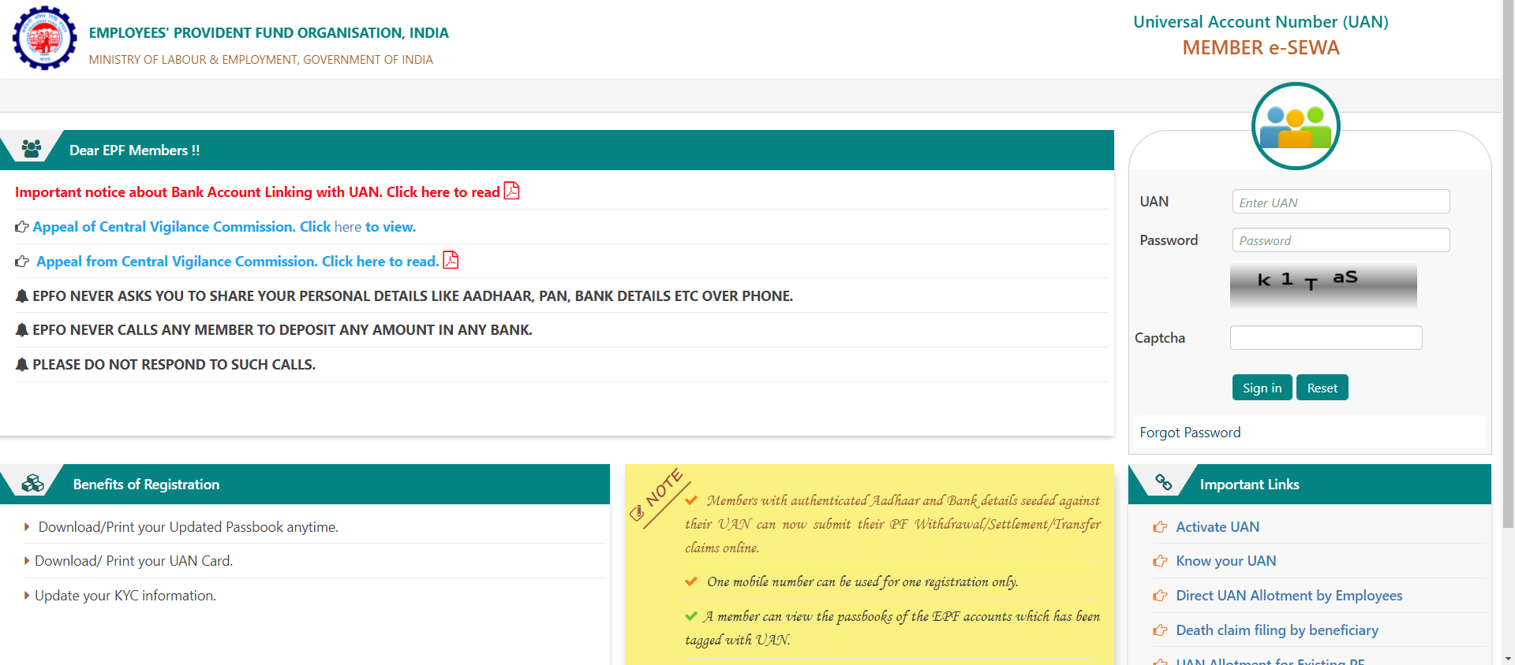
E- nomination (procedure)
Login to UAN member portal (https://unifiedportal-mem.epfindia.gov.in/memberinterface/)

Slide 10
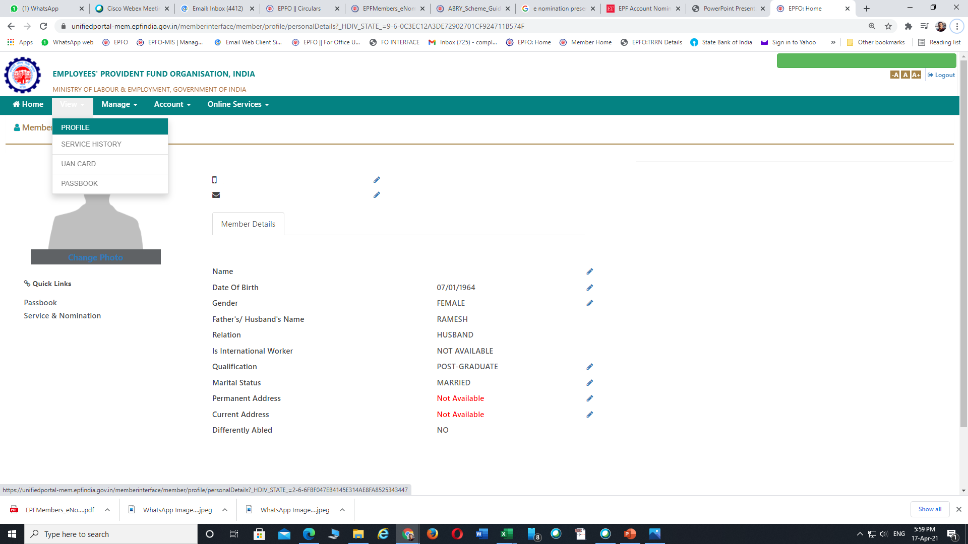
E- nomination (PROFILE UPDATION)
Open “View” >> “Profile” and update all the details of the member if any one left out

Slide 11
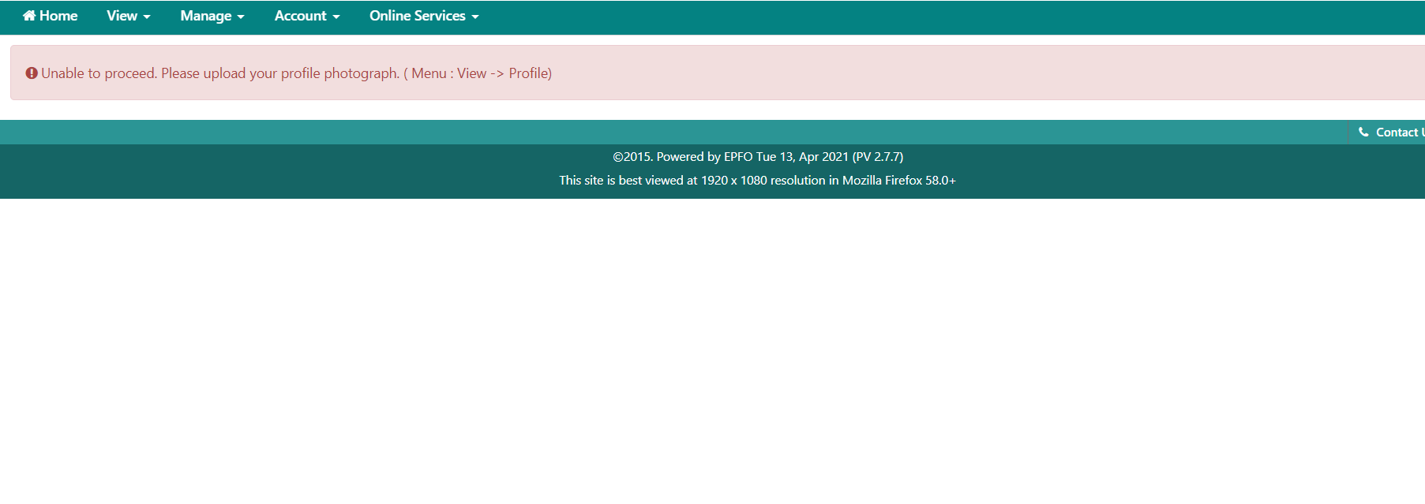
E- nomination (PHOTO UPLOAD)
E- nomination cannot proceed without uploading members photo

Slide 12
E- nomination (PHOTO UPLOAD)
Members photo can be uploaded through >> MEMBER PROFILE >> CHANGE PHOTO option

Slide 13
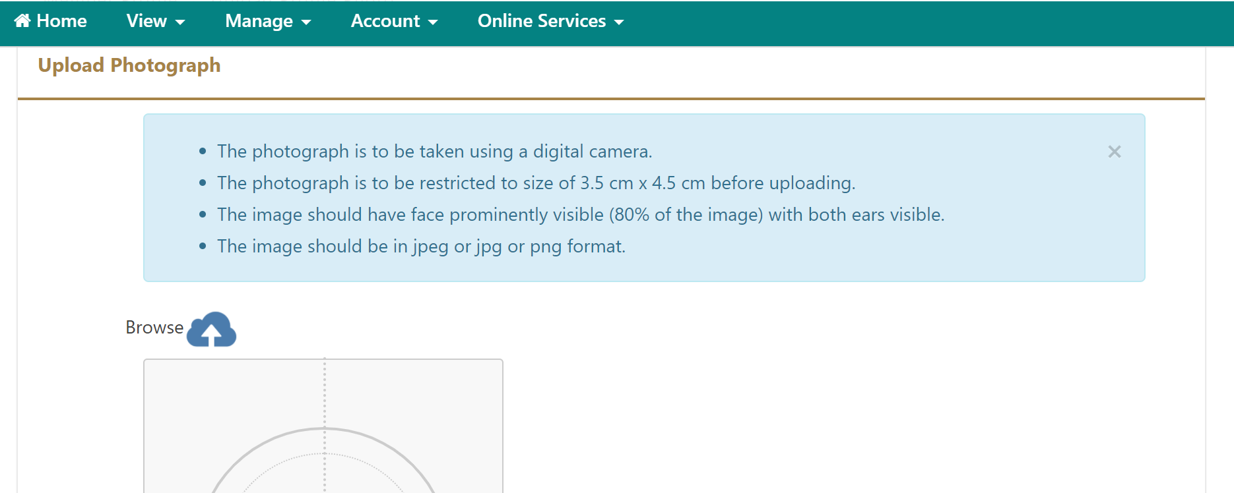
E- nomination (PHOTO UPLOAD)
Things to remember while uploading the Photo

Slide 14
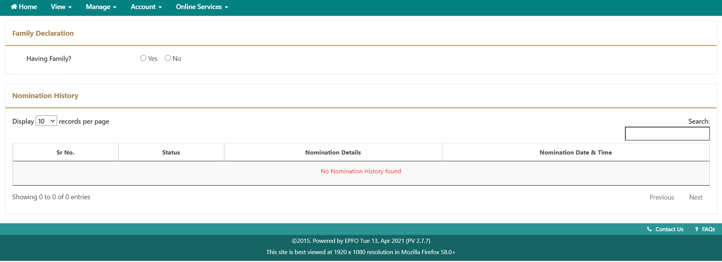
E- nomination (procedure)
Select the appropriate option of “Having family” of member

Slide 15
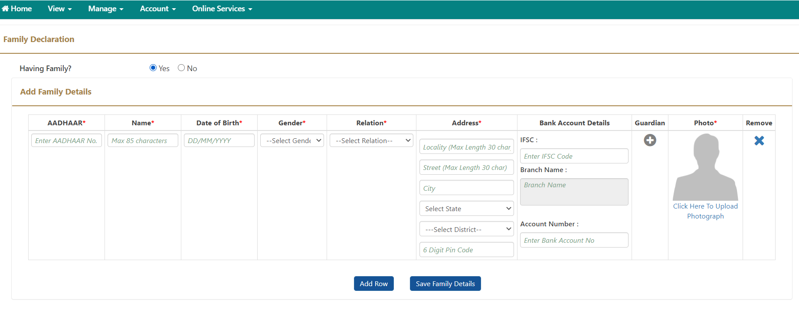
E- nomination (family details entry)
Fill up the necessary details in all the columns and upload the photograph of the nominee and then SAVE.
“ADD ROW” option can be used to add details of multiple nominees if required

Slide 16
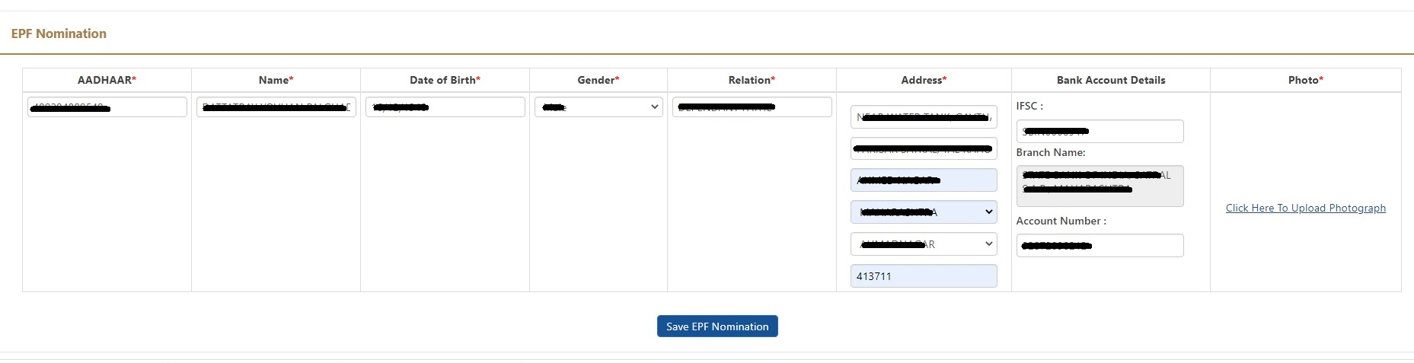
E- nomination (EPF NOMINATION)
Fill up the necessary details of the nominee against Provident Fund Scheme nomination.
Then SAVE EPF Nomination.

Slide 17
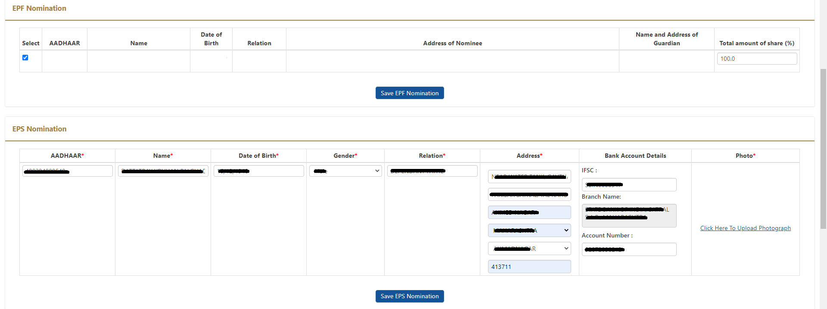
E- nomination (EPs NOMINATION)
Fill up the necessary details of the nominee against Pension Fund Scheme nomination just like which is done in the case of EPF nomination.
Then SAVE EPF Nomination.

Slide 18
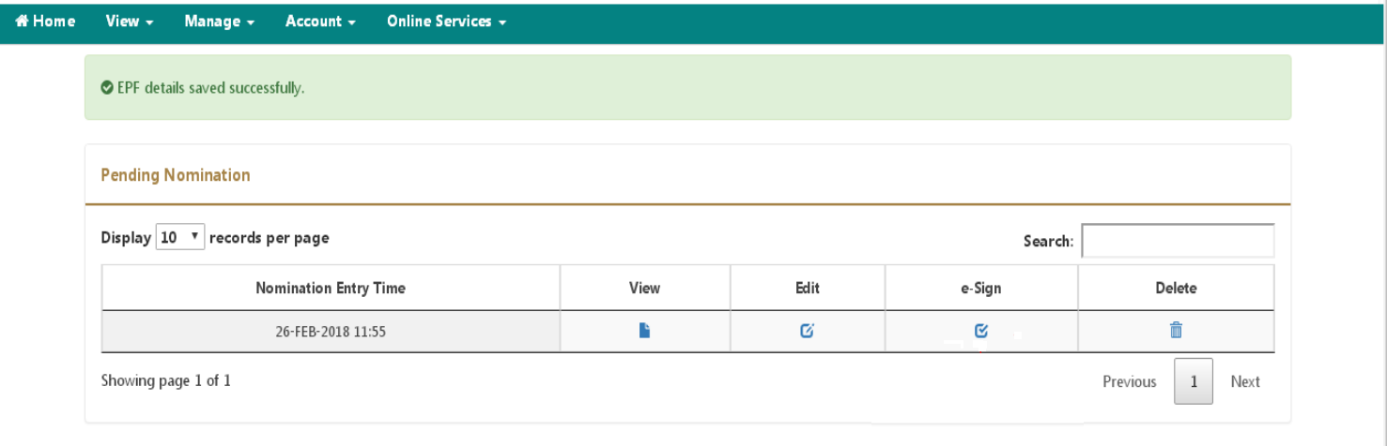
E- nomination (e-signing)
Now the nomination details are to be approved through e-sign (USING AADHAR)

Slide 19
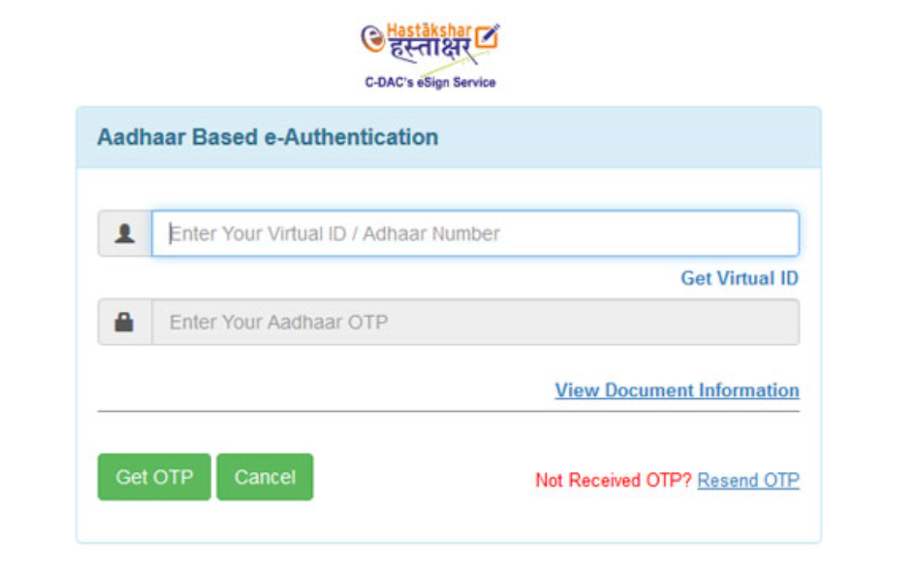
E- nomination (e-signing)
On clicking “e-sign”, a page will be opened for “Aadhar Based e-Authentication”, through which it needs to insert the VIRTUAL ID. This can be generated by the following procedure ………

Slide 20
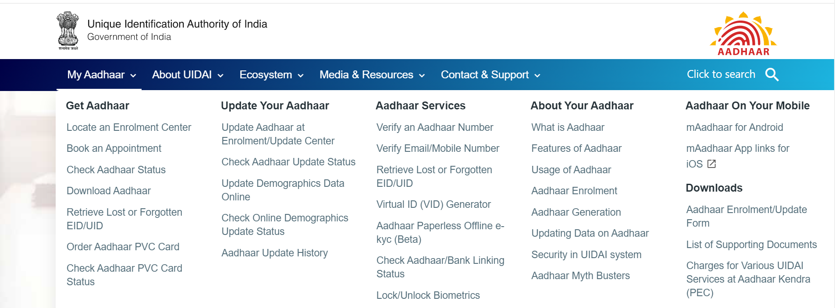
E- nomination (virtual id generator)
Pl login to www.uidai.gov.in site for creation of “VIRTUAL ID”

Slide 21
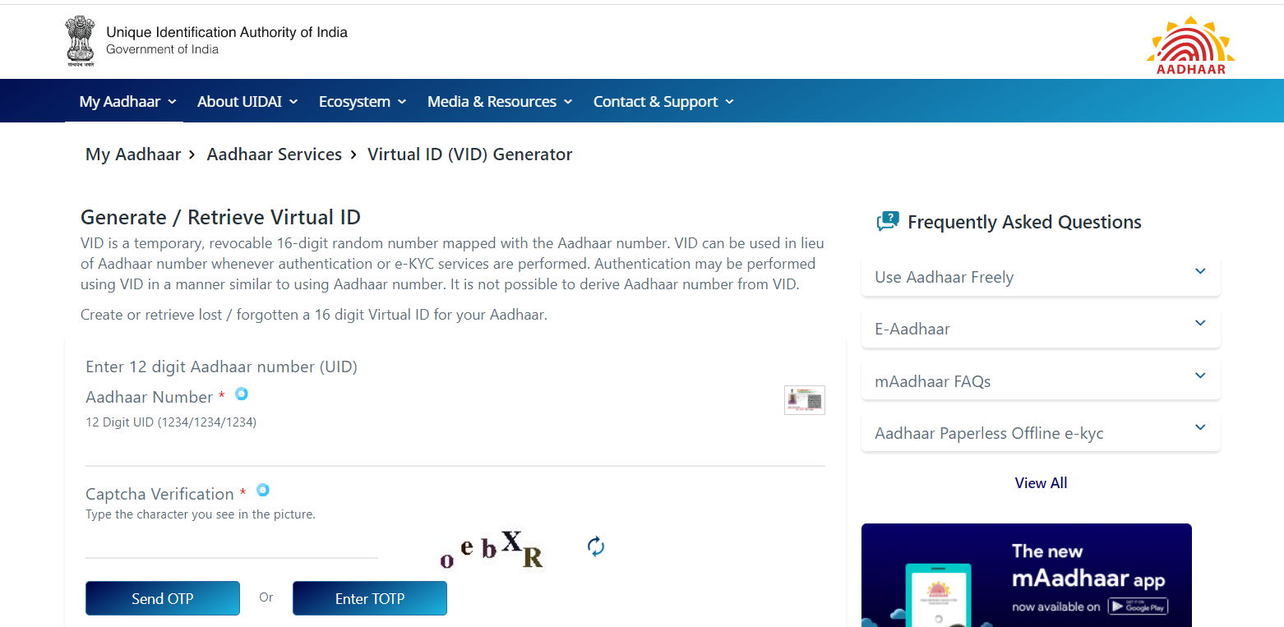
E- nomination (virtual id generator)
Provide the Aadhar number followed by Captcha, OTP will be sent to registered mobile no.

Slide 22
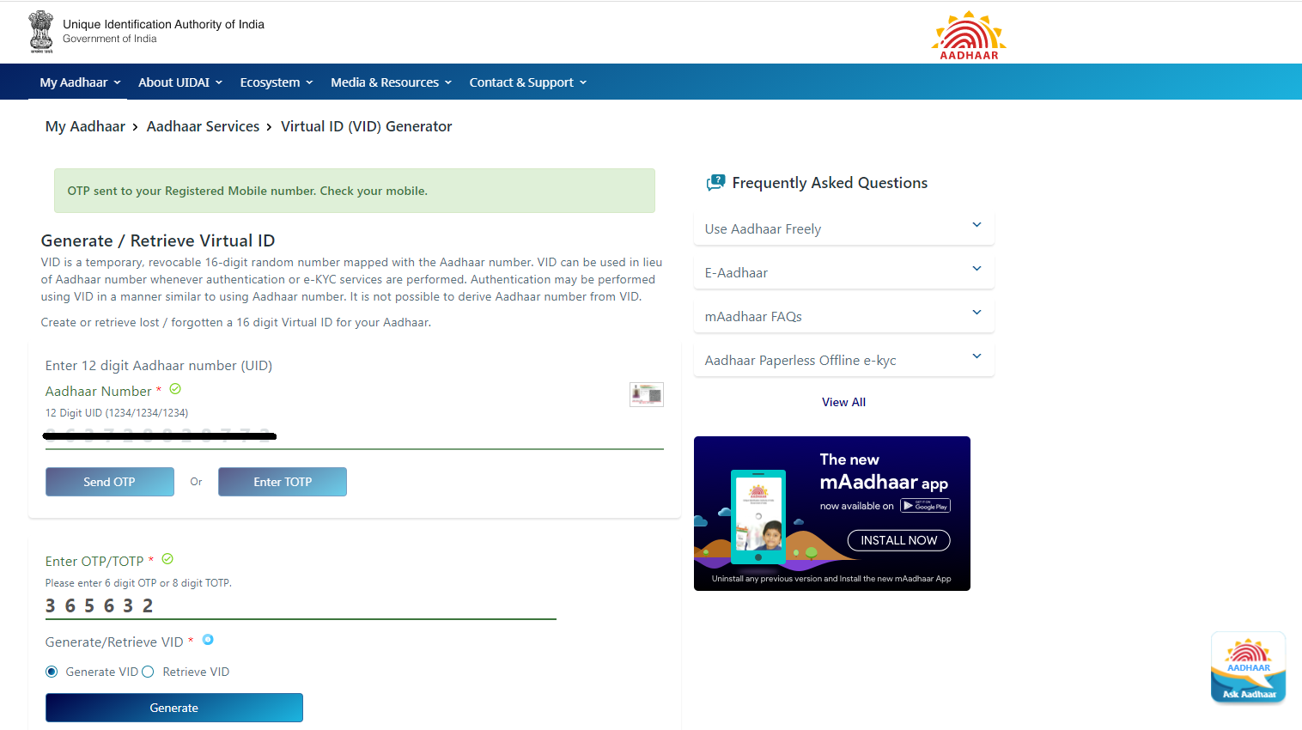
E- nomination (virtual id generator)
On entering OTP, 16 digit Virtual ID will be sent to Aadhar registered mobile number

Slide 23
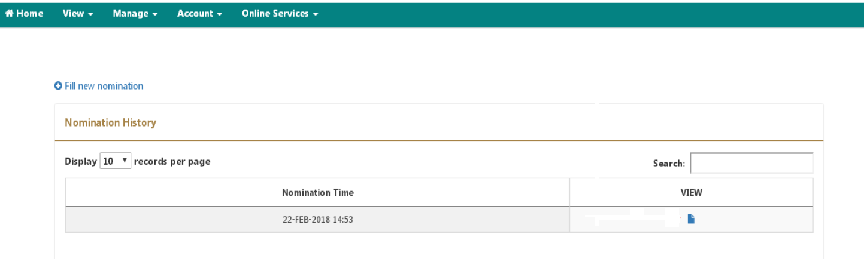
E- nomination (pdf view)
The PDF copy of the nomination can be viewed by clicking on VIEW button

Slide 24
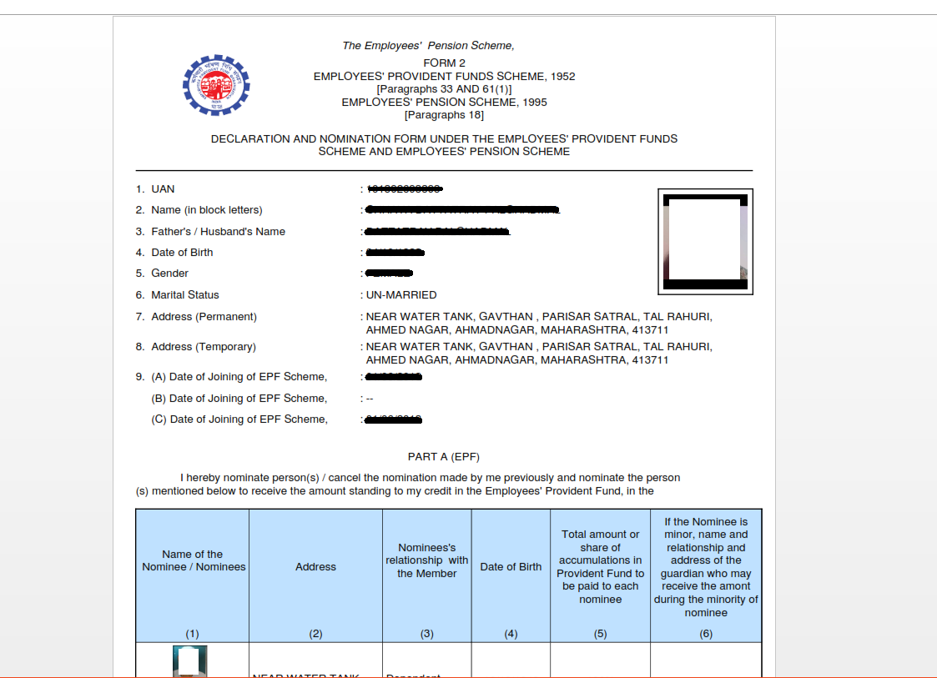
E- nomination (pdf view)

Slide 25


PROCEDURE
Member’s mobile number should be linked with his Aadhar
Log on to EPFO’s website, unifiedportal.mem.epfindia.gov.in and Enter your UAN (Universal Account Number) and password to login
Click on “View” tab and then click on “Profile” option to upload your photo (less than 100 kb) in jpg/jpeg format and update the required details including permanent/correct address.
Then go to click on “Manage” tab and then click on “E-nomination” option
Details like UAN, Name, Date of birth, Gender, Father’s/Husband’s Name, Martial Status, Permanent/current Address, Date of joining in EPF and Date of Joining in EPS appear on the screen. On verification of the said details, click “Proceed” option.
Now, click on “yes” to update family declaration, Subscribers can nominate more than one nominee and also distribute the amount in percentage that may stand to his credit in the Fund amongst his/her nominees at his/her own discretion.
Go to “add family details” and add the details of people you want to nominate. You need to enter the Aadhaar Number, Name & date of birth as per Aadhaar, Relationship, Address of the nominees at his/her own discretion.

Slide 26
Procedures
Go to “add family details” and declare the total amount of share in percentage (%) among your nominee. In case, you would like to nominate only one person as your nominee then you can declare 100% as share.
Click on “save EPF nomination”box.
Now, click on e-sign button and enter your Aadhaar number or (VID) Virtual id of Aadhaar to generate OTP, which will be sent to the registered mobile number, which is linked to your Aadhaar card.
The Aadhaar e-sign facility helps in approving the e-nomination form. Enter the OTP (one-time password.
After this the e-nomination gets registered with the EPFO. A readily available nomination in the system enables to easily file the Pension claim and in the event of the demise to the member his/her nominee will be able to file online claim based on the OTP on his/her Aadhaar Linked Mobile. One doesnot need to apply any physical document to the employer or ex-employer after the online nomination is done.

